Slide 1

1996-2016: Two Decades of Econophysics:
Between Methodological Diversification and Conceptual Coherence
LMU Workshop, July 2016
Christophe Schinckus, School of Management, University of Leicester
Presentation based on my PhD Disseration at University of Cambridge and the book: Financial Economics and Econophysics: An Emerging Dialogue (with F. Jovanovic), Oxford University Press, forthcoming, 2016

Slide 2
Menu …
Introduction
Methodological diversification: first look
Conceptual coherence: the hardcore of econophysics
Methodological diversification:
  Statistical Econophysics
  Bottom up agent based Econophysics
  Top down agent based Econophysics
Evolution of Econophysics
Conclusion

Slide 3
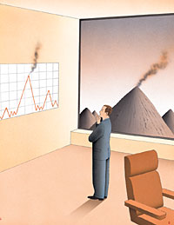
Introduction
Econophysics = “quantitative approach using ideas, models conceptual and computational method of statistical physics” (Mantegna and Stanley, 1996).
≠ transfer and translation of physics concepts in economics.
Importance of the instability (vs equilibrium in economics)
Data-driven models (vs axiomatic approach in economics)
Financial markets = complex systems (emergent properties, scale invariance etc)

Slide 4
Methodological diversification: first look
Statistical Econophysics deals with macro-statistical patterns in economic\financial systems
Bottom up agent based Econophysics aims at reproducing the macro-evolution of economic\financial systems by starting from micro-interactions
Top down agent based Econophysics tries to reproduce the macro-evolution of economic\financial systems by starting from micro-interactions whose calibrations depend on parameters observed at macro-level
Notes:
4

Slide 5
Conceptual coherence
The hard core of econophysics
Area of knowledge | Economic\financial phenomena
Explanandum | Emergent properties based systems
Explanans | By using an asymptotic reasoning
Notes:
5

Slide 6
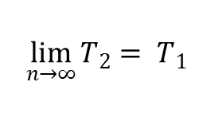
Conceptual coherence
Macro-results can be presented as emergent properties transcending the micro-components’ behaviour. However, this emergence of macro-results must be captured\explained leading each tradition to describes “what is happening” in a different way.
An idea of asymptotic reasoning resulting from a large number of implementations of the reduced theory T₂.
A more encompassing (macro) theory T₁ reduces a specific (micro) theory T₂ if the laws of T₁ can be asymptotically derived from the observations\iterations of T₂ (Batterman, 2002)
$$\lim_{n→∞}{T_{2}= T_{1}}$$
Notes:
6

Slide 7
Methodological diversification in more details
Despite the existence of common ideas conventionally accepted among econophysicists, the literature (Chakraborti et al. 2011a; 2001b; Schinckus, 2013; Ausloos, 2013) devoted to this field indicates that there are several ways of implementing these ideas.
Proliferation of methodological traditions in econophysics results from the intellectual dynamics generated by different treatments of puzzles that econophyscists had to face with.
Notes:
7

Slide 8
Statistical Econophysics
Focus on the macro-results of complex systems whose complexity is assumed to be statistically captured through the analysis of a large sample of data.
The high number of observations is a necessary condition of this approach in order to justify the emergence of macro-regularities through the asymptotic reasoning.
The interaction between all single elements is considered as too complex to be individually described. Only a passage to the limit with a very high number of data can help scholars to identify patterns and “make the jump” between the micro and the macro level.
Notes:
8

Slide 9
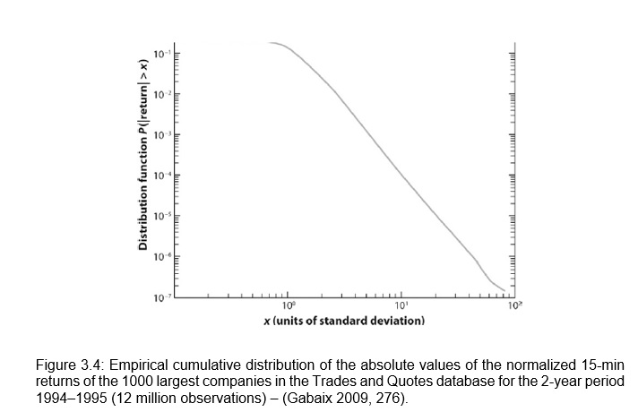
Statistical Econophysics
Notes:
9

Slide 10
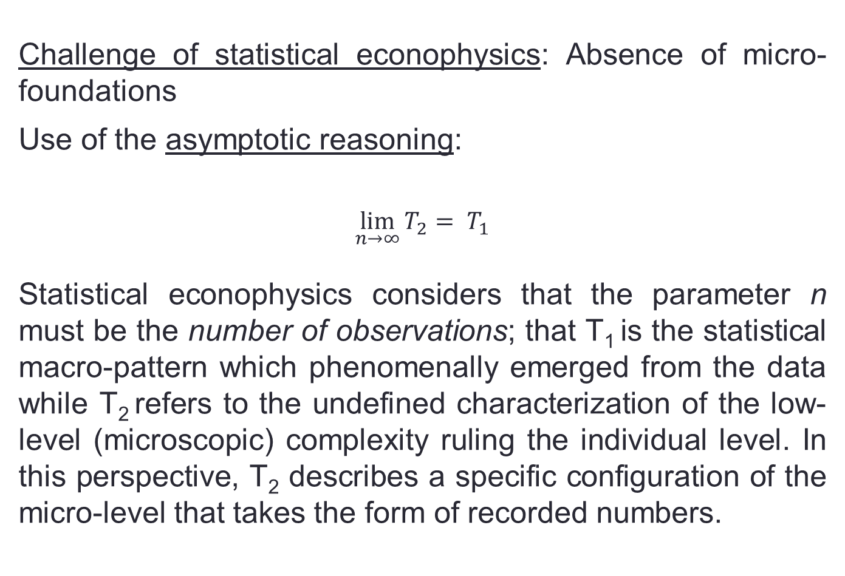
Statistical Econophysics
Challenge of statistical econophysics: Absence of micro-foundations
Use of the asymptotic reasoning:
$$\lim_{n→∞}{T_{2}= T_{1}}$$
Statistical econophysics considers that the parameter n must be the number of observations; that T₁ is the statistical macro-pattern which phenomenally emerged from the data while T₂ refers to the undefined characterization of the low-level (microscopic) complexity ruling the individual level. In this perspective, T₂ describes a specific configuration of the micro-level that takes the form of recorded numbers.
Notes:
10

Slide 11
Bottom up Agent Based Econophysics
Bottom up AB econophysics requires the definition of fundamental constraints which takes the form of pre-defined rules describing the micro-interactions between elements.
Afterwards, a large number of interactions are simulated thanks to computational power. The high number of iterations is then supposed to show the major statistical\mathematical properties of the simulated system
Notes:
11

Slide 12
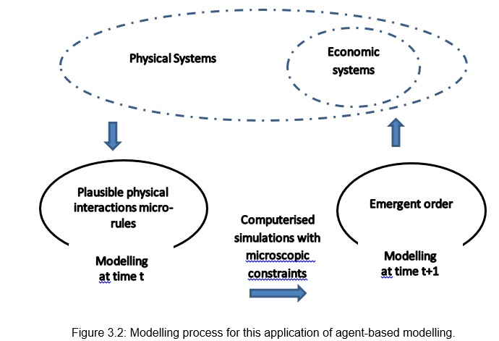
Bottom up Agent Based Econophysics
Pickhardt and Seibold (2011), for example, explained that income tax evasion dynamics can be modelled through an “agent-based econophysics model” based on the Ising model of ferromagnetism
Notes:
12

Slide 13
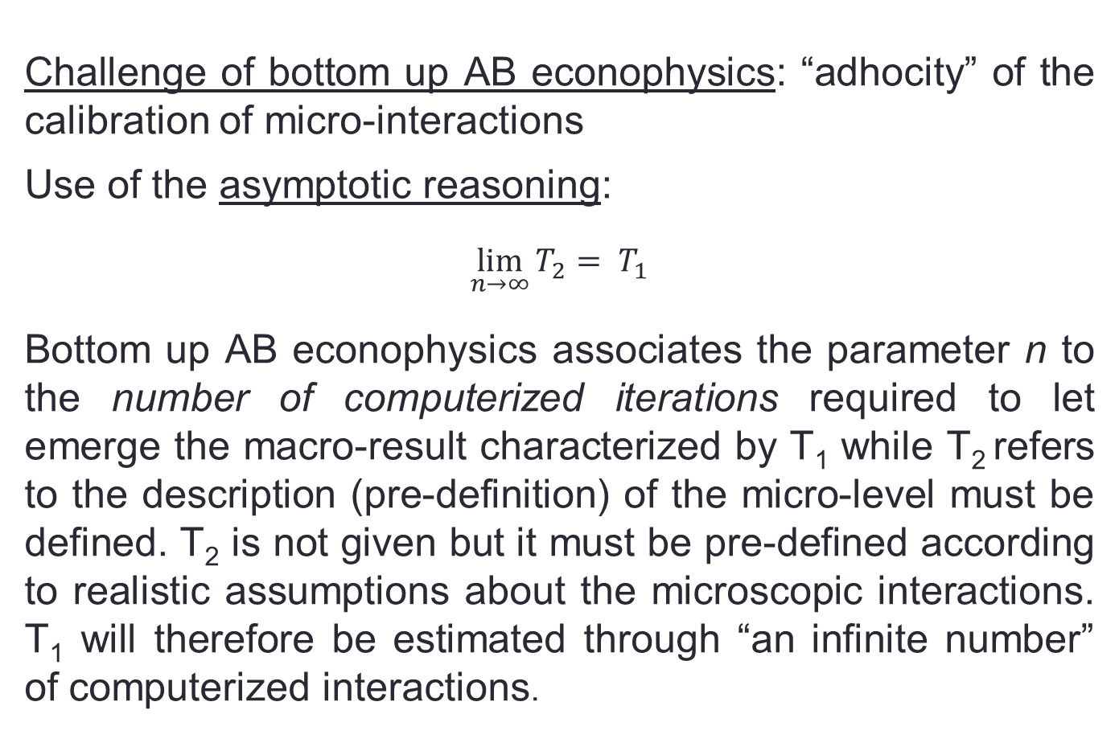
Bottom up Agent Based Econophysics
Challenge of bottom up AB econophysics: “adhocity” of the calibration of micro-interactions
Use of the asymptotic reasoning:
$$\lim_{n→∞}{T_{2}= T_{1}}$$
Bottom up AB econophysics associates the parameter n to the number of computerized iterations required to let emerge the macro-result characterized by T₁ while T₂ refers to the description (pre-definition) of the micro-level must be defined. T₂ is not given but it must be pre-defined according to realistic assumptions about the microscopic interactions. T₁ will therefore be estimated through “an infinite number” of computerized interactions.
Notes:
13

Slide 14
Top down Agent Based Econophysics
Top down AB econophysics offers a technique in which the inputs include specific statistical characteristics inferred from the observed system (i.e. the existence of a power law with defined parameters, for instance)
In accordance with the purpose of the bottom-up agent-based econophysics, the objective is to reproduce data observed for existing systems through a high number of computerized iterations of statements algorithmically constrained. However, in contrast with the bottom up approach assuming that macro-results can be derived from the micro-levels, the top-down perspective tries to combine the two traditions evoked before
Notes:
14

Slide 15
Top down Agent Based Econophysics
In the top down AB econophysics, behaviour of lower-level components in a system within micro-components are said to be determined by macro-properties as Rickles (2008, p.7) explained it:
"The idea is that in statistical physics, systems that consist of a large number of interacting parts often are found to obey 'universal laws' […] and dependent on just a few macroscopic parameters".
Notes:
15

Slide 16
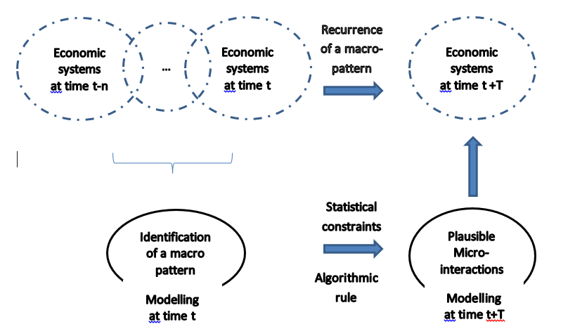
Top down Agent Based Econophysics
Feng and al (2012, p.8388): “the interaction strength between agents need to be adjusted with agent population size or interaction structure to sustain fat tails in return distributions [i.e. power-law]”
Notes:
16

Slide 17
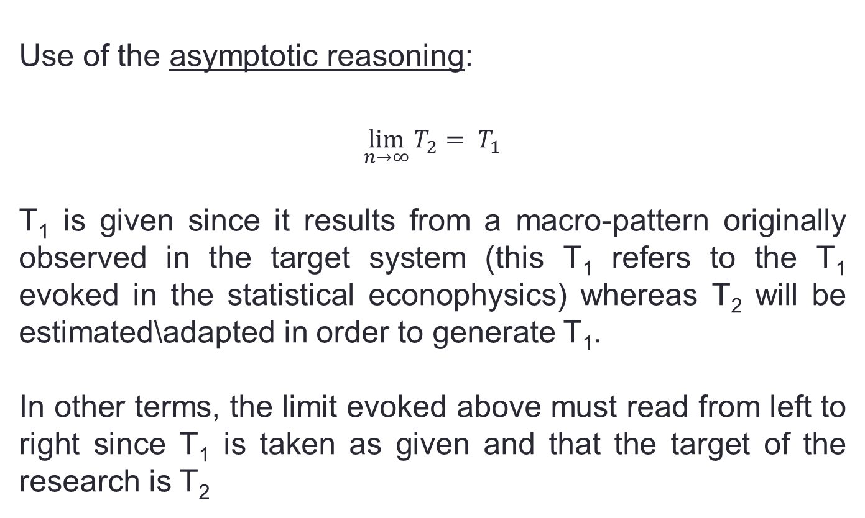
Top down Agent Based Econophysics
Use of the asymptotic reasoning:
$$\lim_{n→∞}{T_{2}= T_{1}}$$
T₁ is given since it results from a macro-pattern originally observed in the target system (this T₁ refers to the T₁ evoked in the statistical econophysics) whereas T₂ will be estimated\adapted in order to generate T₁.
In other terms, the limit evoked above must read from left to right since T₁ is taken as given and that the target of the research is T₂
Notes:
17

Slide 18
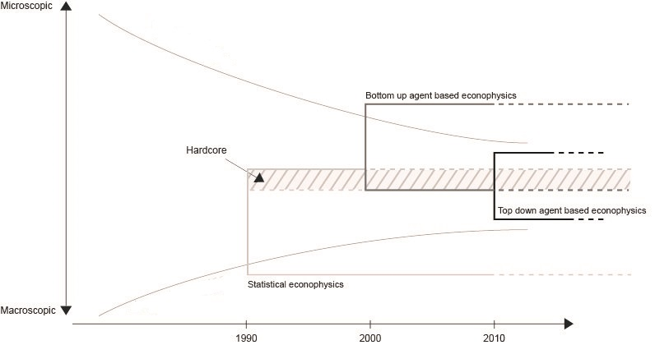
Evolution of Econophysics
Notes:
18

Slide 19
Evolution of Econophysics
Absence of a “crucial experiment” allows econophysicists to stop to use a specific approach…
The co-existence of these three methodological approaches is very interesting from a philosophical point of view. Beyond the question of the field coherence, this methodological diversity characterizes different ways of dealing with asymptotic reasoning and concepts such as emergence, reduction, derivability\deducibility etc.

Slide 20
Conclusion
One can observe a methodological diversification of econophysics with the co-existence of three traditions of works.
Through a Lakatosian framework, I showed how this diversification can be seen as an extension of the conceptual protective belt of auxiliary assumptions surrounding the core assumptions of econophysics.
This extension calls for more philosophical works !!

Slide 21
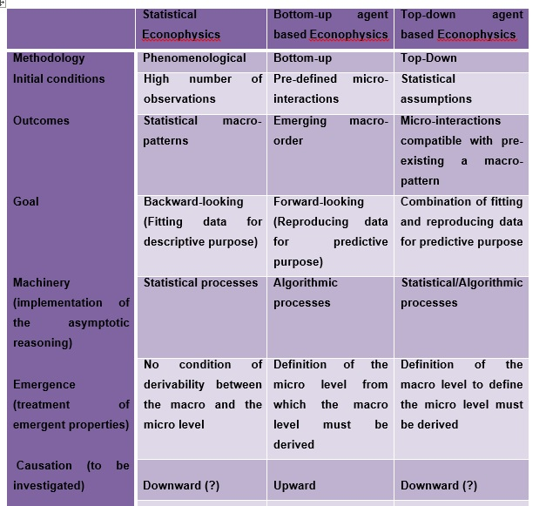

Slide 22

Thank you for your attention

